Slide 1

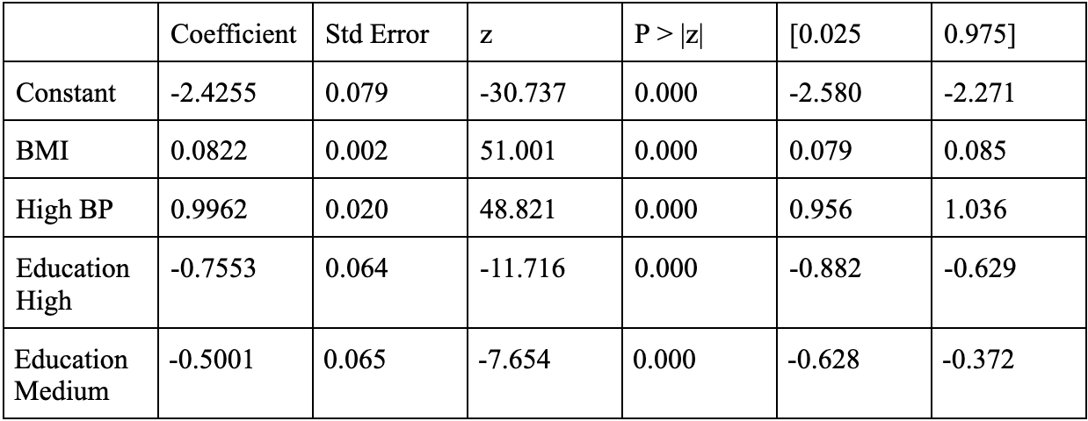
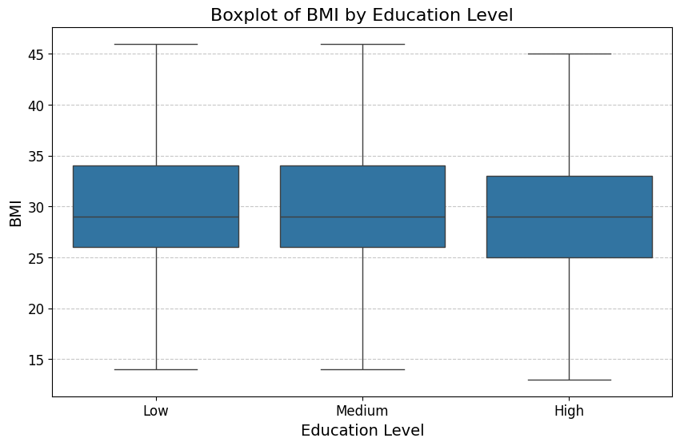
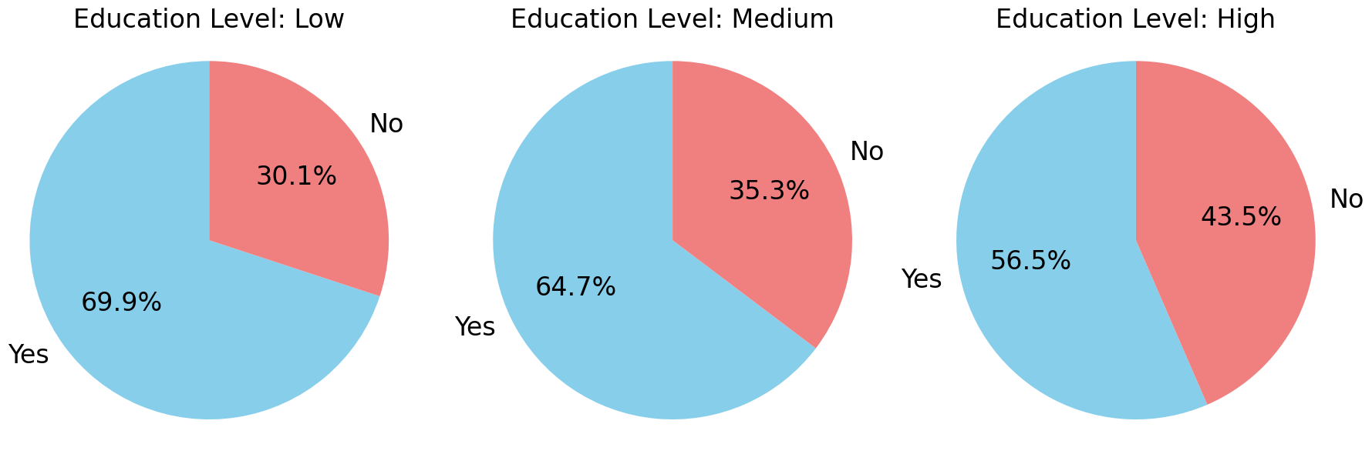
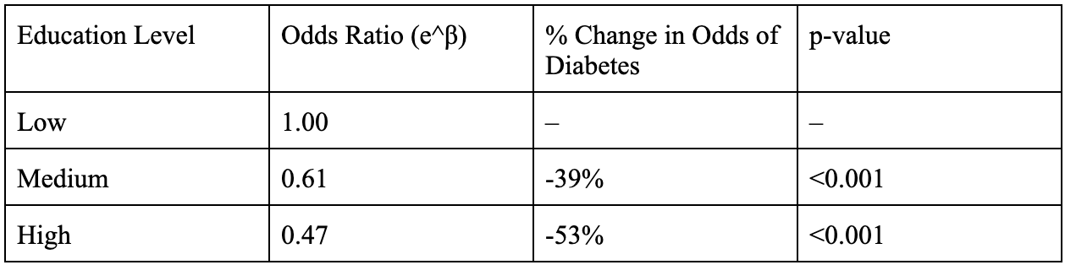
Relationship between educational attainment and development of diabetes
Payton Berry¹
Faculty Advisor: MinJae Woo, Ph.D.
¹Clemson University, Clemson, SC
Abstract
RESULTS
Diabetes is a widespread chronic disease and a leading contributor to cardiovascular complications, morbidity, and mortality worldwide. In the United States, its prevalence continues to rise, placing significant strain on healthcare systems and highlighting the need for effective prevention strategies. While clinical factors such as body mass index (BMI) and hypertension are well-established predictors, the role of educational attainment in contributing to diabetes risk requires further clarification. The goal of this study was to assess the relationship between educational attainment and diabetes risk, comparing its influence to key clinical predictors of BMI and hypertension.
A case-control analysis was conducted using a large health dataset of 47,840 participants. Diabetes status was modeled using logistic regression with BMI, hypertension status, and education categorized into low, medium, and high levels and predictors. Associations were estimated using maximum likelihood, and results are reported as coefficients, odds ratios, and p-values. BMI and hypertension were strong predictors of diabetes, while educational attainment showed a significant protective effect.
While clinical factors remain the primary drivers of diabetes risk, higher educational attainment is independently associated with reduced risk in a graded manner. These findings underscore the importance of incorporating both clinical and social determinants into diabetes prevention and public health strategies.
Regression Table
The logistic regression model was statistically significant (p<0.001). Higher BMI was associated with increased odds of diabetes, and individuals with hypertension had substantially higher odds of diabetes. Educational attainment showed a significant protective effect.
The boxplot shows that BMI distributions are relatively similar across education levels, with comparable medians and ranges. This suggests that differences in diabetes risk by education are not solely explained by BMI differences.
The pie charts indicate that the prevalence of high blood pressure decreases as education level increases. This trend suggests that lower education is associated with higher prevalence of hypertension, which may partially contribute to increased diabetes risk.
Overall, the results demonstrate that the clinical factors of BMI and hypertension strongly predict diabetes, and higher education is consistently associated with lower diabetes risk. The relationship between education and diabetes appears independent of BMI and partially related to differences in hypertension prevalence.
Pie Chart of High BP by Education Level
BACKGROUND
Education Level vs Diabetes Risk
Diabetes is a major public health concern influenced by both clinical and socioeconomic factors. Elevated body mass index (BMI) and hypertension are well-established clinical risk factors for diabetes, and both of which are closely linked to metabolic dysfunction and disease progression.
Beyond clinical factors, there is growing recognition that socioeconomic factors, such as education, income, and access to resources, play a critical role in shaping health outcomes. Educational attainment in particular may influence diabetes risk through multiple pathways, including health literacy, lifestyle behaviors, access to preventive care, and the ability to navigate healthcare systems. However, the independent contribution of education to diabetes risk, relative to strong clinical predictors, remains less clearly defined.
This study aimed to determine the relationship between educational attainment and diabetes risk, as well as comparing the established clinical predictors of BMI and hypertension to educational attainment.
Understanding this relationship is important for both clinical practice and public health policy. If education is shown to significantly impact diabetes risk, it may be valuable in identifying high-risk populations and tailoring prevention efforts. Additionally, these findings could inform interventions to support more comprehensive and equitable approaches to diabetes prevention and care.
DISCUSSION
This analysis examined the relationship between educational attainment and diabetes risk while controlling for key clinical predictors. Consistent with previous findings, BMI and hypertension remain strong and highly significant predictors of diabetes. These results reinforce the well-established role of metabolic and cardiovascular factors in the development of diabetes.
Educational attainment shows a clear and statistically significant association across all levels. Both medium and high education levels were associated with reduced odds of diabetes, with a stronger protective effect observed at higher levels of education. This pattern suggests a graded relationship, where increasing education corresponds to progressively lower diabetes risk.
There are several mechanisms that may explain the observed relationship between education and reduced diabetes risk. The understanding of nutrition, exercise, and disease prevention, or health literacy, may be improved as education level increases. Behaviorally, more educated individuals may engage in healthier lifestyles. Greater education is also often associated with better access to preventive care and early intervention. Overall, socioeconomic advantages such as stable income, occupation security, and safe living conditions are common outcomes of higher education levels.
Because this was an observational study, correlation can be assumed, but causal relationships are not able to be established. There is also a risk of potential confounding, as variables such as income, diet, and physical activity were not included. Also, the self-reporting nature of some of the variables may introduce recall or reporting bias. The simplification of education levels into “high,” “medium,” and “low” may cause finer distinctions to be overlooked.
Methods
A case-control study design was used with a large health survey dataset of 47,840 participants. Participants with diabetes were classified as cases and participants without diabetes were classified as controls. The dataset includes both self-reported and measured health indicators, as well as demographic and socioeconomic variables, which allows for comparison of risk factors between groups.
The outcome variable examined was diabetes status, a binary variable. The primary explanatory variable was educational attainment, a categorical variable, with the lowest education level as the reference category. BMI and hypertension were additional explanatory variables, with BMI being a continuous variable and hypertension being a binary variable.
Logistic regression was used to estimate the association between educational attainment and the odds of diabetes prevalence, while adjusting for BMI and hypertension status. Maximum Likelihood Estimation (MLE) was used and log-odds of diabetes were modeled as a function of education level, BMI, and blood pressure status. The results were reported as regression coefficients (β), odds ratios (e^β), and p-values, with statistical significance defined at ɑ = 0.05.
CONCLUSION
While BMI and hypertension remain key clinical predictors of diabetes, higher educational attainment is independently associated with reduced risk, emphasizing the importance of addressing both clinical and socioeconomic factors in diabetes prevention and management. The pattern in the data suggests a graded relationship, where increasing education is associated with progressively lower diabetes risk, even after adjusting for major clinical factors. Because of this relationship, education level may serve as a useful indicator for identifying populations at higher risk and tailoring prevention strategies from a clinical perspective. From a public health perspective, interventions that improve health literacy and education access, promote preventive behaviors in lower-education populations, and integrate social and clinical risk factors in disease prevention efforts are supported by these findings.

